Slide 1
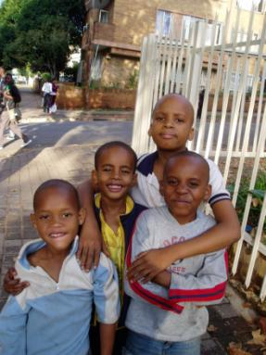
PROPOSED TRANSFORMATION
OF
THE SPORTS GROUND PRECINCT
MARIUS ERASMUS

Slide 2
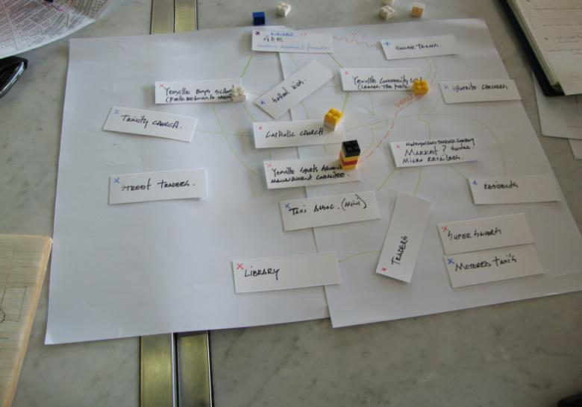
SPORTS GROUND PRECINCT
www.yeoville.org.za
INTERVIEWS AND SOCIAL MAPPING : THE STAKEHOLDERS

Slide 3
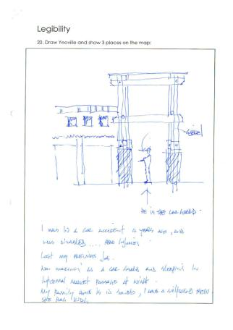
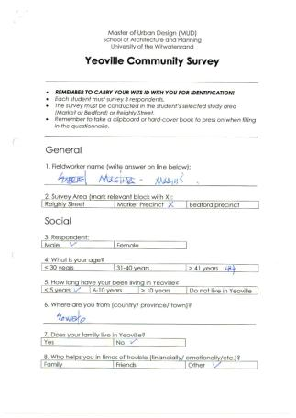
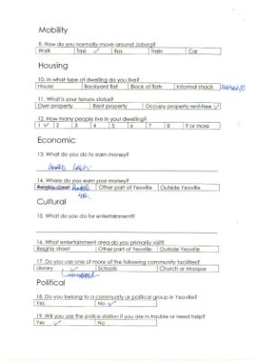
SPORTS GROUND PRECINCT
INTERVIEWS AND SOCIAL MAPPING : THE STAKEHOLDERS

Slide 4
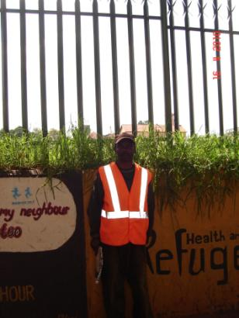
SPORTS GROUND PRECINCT
THE STAKEHOLDERS
Department of public works
Gauteng Department of Education
Yeoville Boys School
Yeoville Community School
Yeoville Sports ground Management Committee
The Catholic Church
The Yeoville Market
Yeoville community.
JRA
GABRIEL THE CARGUARD
INTERVIEWS AND SOCIAL MAPPING : THE STAKEHOLDERS

Slide 5
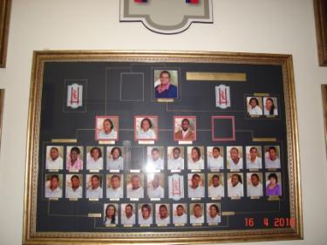
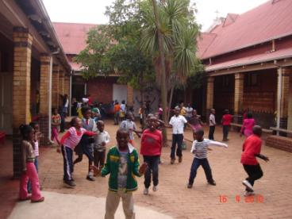
SPORTS GROUND PRECINCT
MEETING WITH YEOVILLE SPORTS GROUND MANAGEMENT COMMITTEE
The following items discussed in the meeting was very relevant to our first design ideas:
The sport grounds belong to the ‘’Department of Public Works’’. They don’t have to go through any channels to make discussions about the sports field and often make discussions without the knowledge of the ‘’Sports ground management committee’’. They made the decision to allow Telkom to use part of the sports field for the next 2-3 years until the damages interchange is re-built.
St. Johns school has offered to maintain the sports field as part of teaching their boys to reach out to less fortunate communities.
They discussed the possibility of creating a fan park on the sports field during the World Cup Soccer event, and they are looking at getting sponsors to provide a big screen and to help them control access.
They were looking at approaching the ‘’Telkom foundation’’ for help and funding in this regard.
The Father of the Catholic church is a member of the sports field management committee, and was interested to discuss the proposal for closing Muller road between the community school and the sports field. All present were concerned about the so called technocrats at local Jhb Council with regards to closing the road but felt there was president, as they closed Frances street in the 1960’s to allow the ‘’Yeoville Boys School’’ to be linked to its current sports field.
They also discussed the possibility of having a small soccer tournament on the sports field during Africa week that concludes on the 29th of May 2010.
The most urgent order of business was to set out and paint a full size soccer field.
The YSGMC was approached by the previous Principal of the Yeoville Community School, with a possible sponsor that wants to build a basketball facility on the grounds and manage it for a period of five years. It was decided to invite this possible sponsor to the next meeting.
The possibility of sinking a bore hole on the site was discussed to enable them to irrigate the field without cost.
INTERVIEWS AND SOCIAL MAPPING : THE STAKEHOLDERS

Slide 6
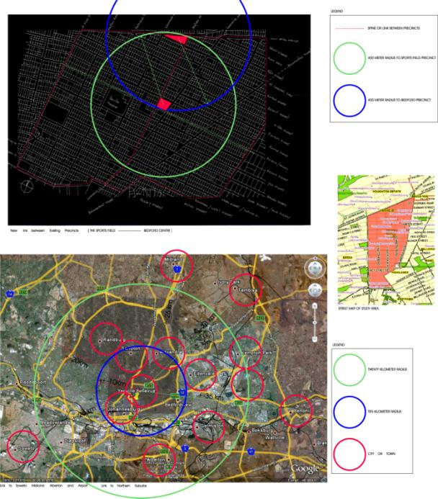
YEOVILLE LOCALITY
OVERALL MAPPING AND SITE SELECTION

Slide 7
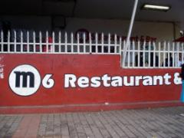
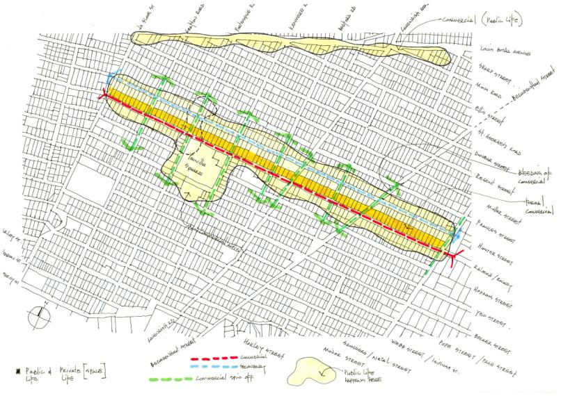
YEOVILLE MAPPING
PUBLIC AND PRIVATE REALM
OVERALL MAPPING AND SITE SELECTION

Slide 8
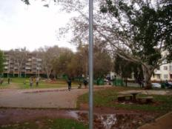
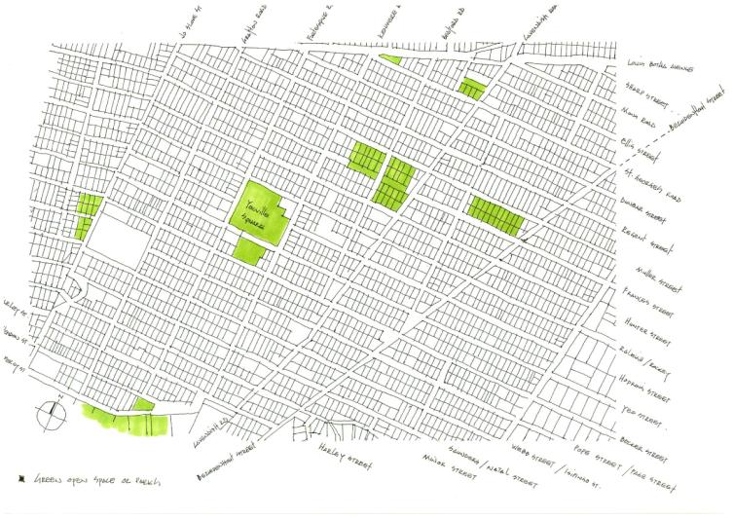
YEOVILLE MAPPING
PHYSICAL ELEMENTS AND OPEN SPACES
OVERALL MAPPING AND SITE SELECTION

Slide 9
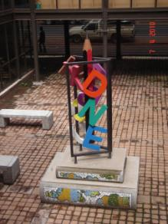
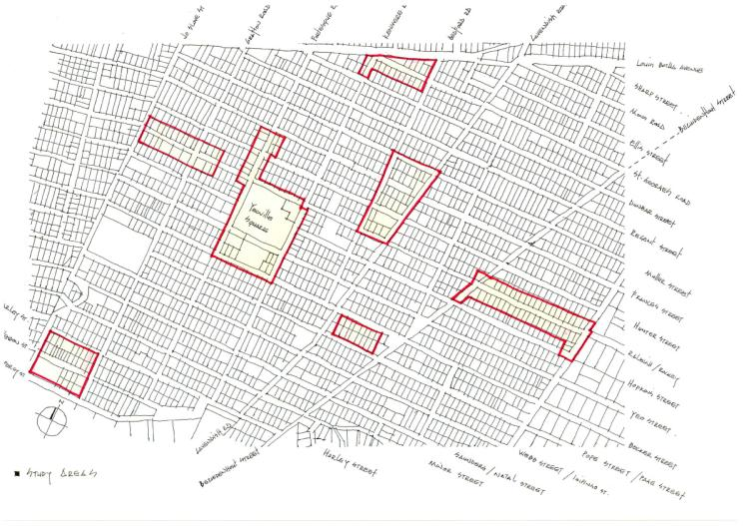
INITIAL STUDY AREAS
ORIGINAL STUDY AREAS
OVERALL MAPPING AND SITE SELECTION

Slide 10
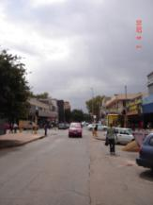
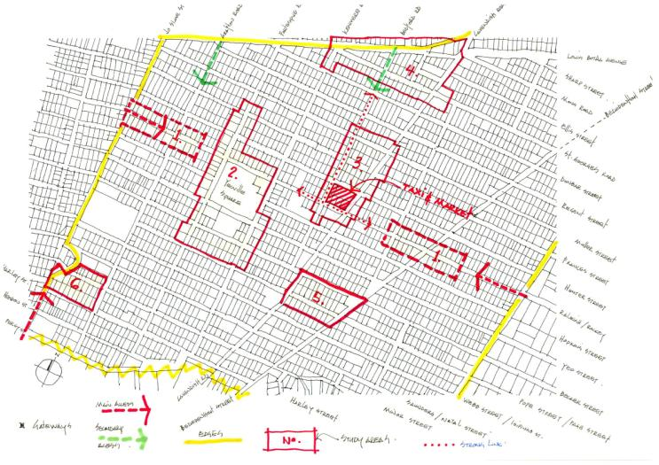
YEOVILLE MAPPING
GATEWAYS
OVERALL MAPPING AND SITE SELECTION

Slide 11
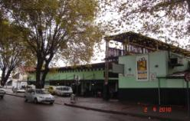
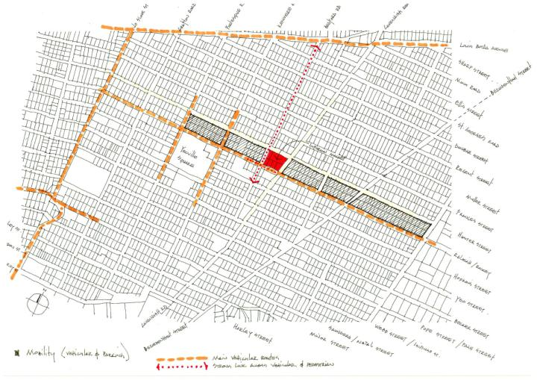
YEOVILLE MAPPING
PUBLIC AND PRIVATE REALM
OVERALL MAPPING AND SITE SELECTION

Slide 12
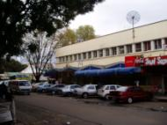
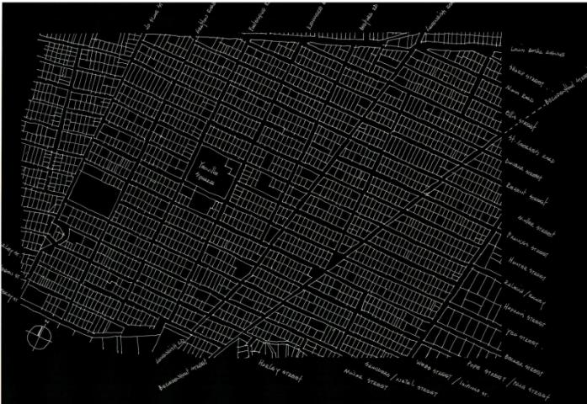
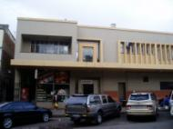
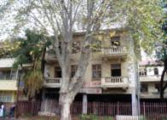
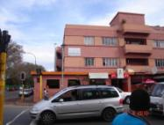
INITIAL STUDY AREA -FORTESQUE AND HUNTER STREET - INCLUDING YEOVILLE SQUARE
OVERALL MAPPING AND SITE SELECTION

Slide 13
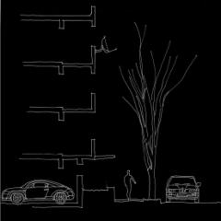
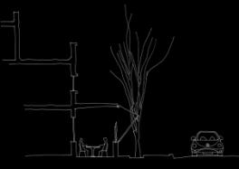
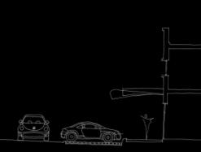
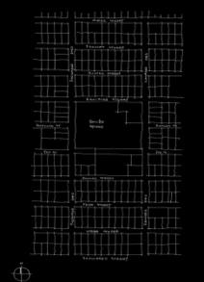
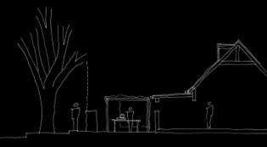
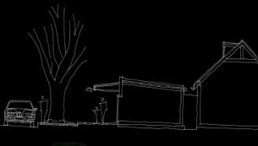
FORTESQUE AND HUNTER STREET INCLUDING YEOVILLE SQUARE
SECTION THROUGH TAVERNA ON CRN HUNTER & FORTESQUE
SECTION THROUGH ARCADE AT SHOPS ON FORTESQUE ROAD
SECTION THROUGH APARTMENTS ON
FORTESQUE ROAD
PRIVATE AND PUBLIC REALM
SECTION THROUGH FRONT YARD SPASA
SECTION THROUGH FRONT YARD MINI MARKET
MAP OF STUDY AREA
OVERALL MAPPING AND SITE SELECTION

Slide 14
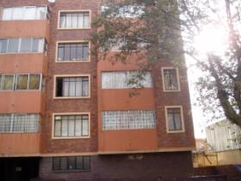
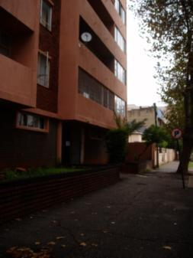
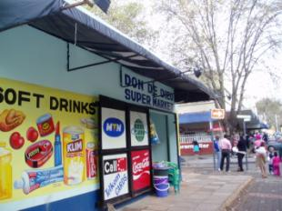
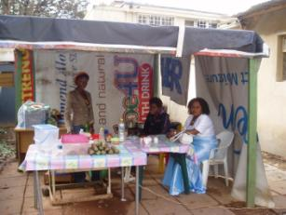
FORTESQUE AND HUNTER STREET INCLUDING YEOVILLE SQUARE
PRIVATE AND PUBLIC REALM
OVERALL MAPPING AND SITE SELECTION

Slide 15
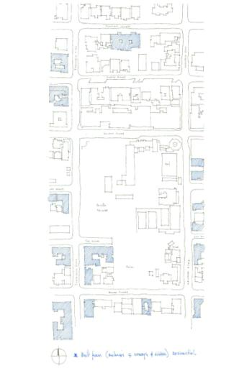
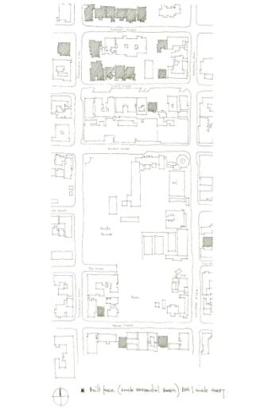
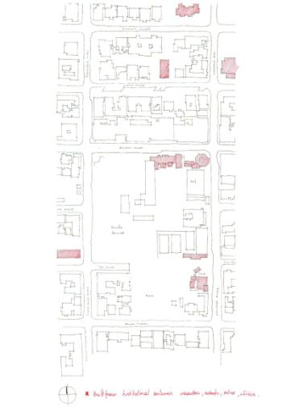
FORTESQUE AND HUNTER STREET INCLUDING YEOVILLE SQUARE
INSTITUTIONAL BUILDINGS
CHURCHES, SCHOOLS, POLICE & CLINICS
BUILDINGS FOUR STOREYS AND HIGHER
RESIDENTIAL -1 HOUSES
OVERALL MAPPING AND SITE SELECTION

Slide 16
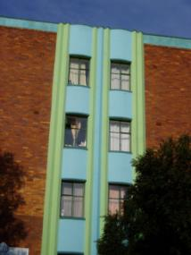
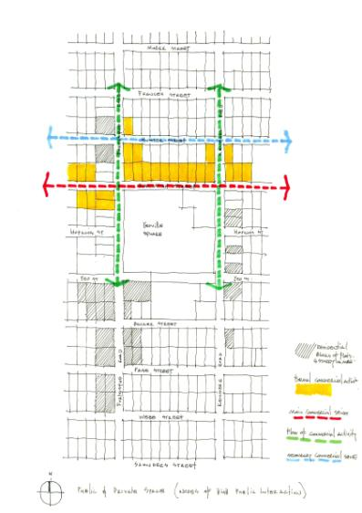
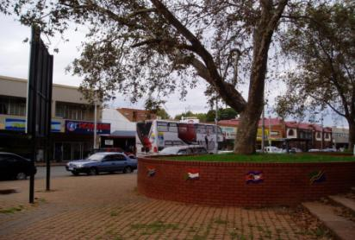
FORTESQUE AND HUNTER STREET INCLUDING YEOVILLE SQUARE
PUBLIC AND PRIVATE REALM
OVERALL MAPPING AND SITE SELECTION

Slide 17
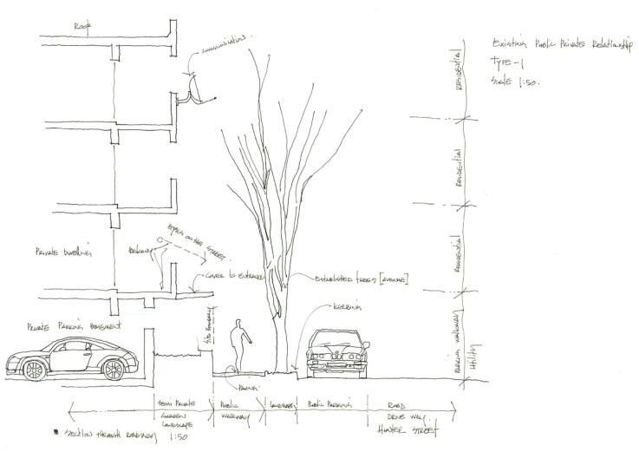
FORTESQUE AND HUNTER STREET INCLUDING YEOVILLE SQUARE
PRIVATE AND PUBLIC REALM
OVERALL MAPPING AND SITE SELECTION

Slide 18
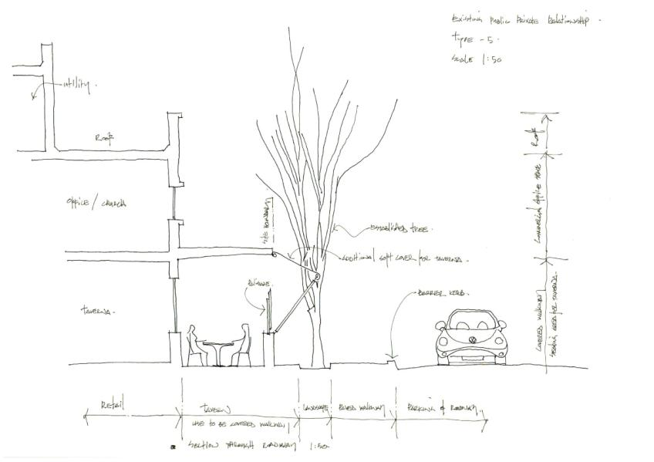
FORTESQUE AND HUNTER STREET INCLUDING YEOVILLE SQUARE
PRIVATE AND PUBLIC REALM
OVERALL MAPPING AND SITE SELECTION

Slide 19
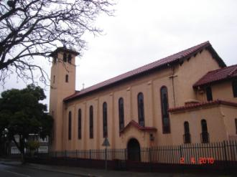
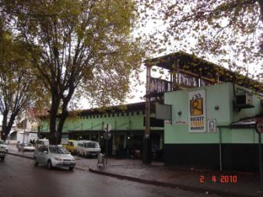
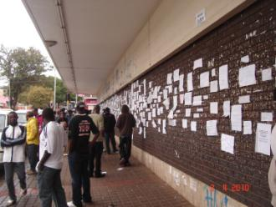
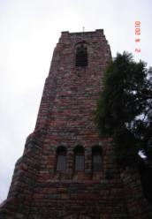
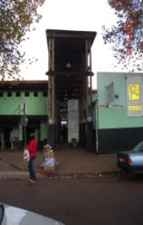
SPORTS GROUND PRECINCT
FINAL SITE SELECTION

Slide 20
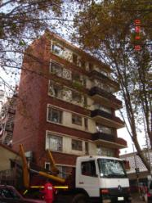
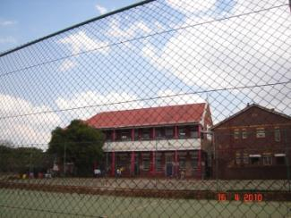
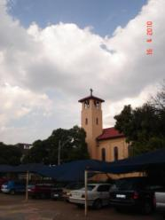
SPORTS GROUND PRECINCT
FINAL SITE SELECTION

Slide 21
SPORTS GROUND PRECINCT
PRIVATE AND PUBLIC REALM
FINAL SITE SELECTION

Slide 22
TWO SCHOOLS OF THOUGHT

Slide 23
SPORTS GROUND PRECINCT
PRACTICAL SOLUTION
FINAL SITE SELECTION

Slide 24
SPORTS GROUND PRECINCT
VISIONARY SOLUTION
FINAL SITE SELECTION

Slide 25
THE DESIGN

Slide 26
THE DESIGN

Slide 27
THE DESIGN
CROSS SECTION NORTH SOUTH THROUGH HUNTER STREET

Slide 28
THE DESIGN
CROSS SECTION EAST WEST THROUGH BEDFORD STREET

Slide 29
THE DESIGN
CROSS SECTION EAST WEST THROUGH CAVENDISH STREET

Slide 30
THE DESIGN
SITE PLAN SPORTS GROUND PRECINCT

Slide 31
THE DESIGN
TYPICAL CROSS SECTION ACROSS HUNTER STREET AT MARKET LINK

Slide 32
THE DESIGN
CROSS SECTION EAST WEST ACROSS BEDFORD AND CAVENDISH

Slide 33
THE DESIGN
LONG SECTION NORTH SOUTH ACROSS MULLER AND HUNTER STREET

Slide 34
THE MODEL

Slide 35
THE MODEL

Slide 36
IMPLEMENTATION

Slide 37
HOW WILL THE DESIGN BE IMPLEMENTED ?
Consultation with the community.
Consultation with department of public works.
Will most likely not be successful, without the involvement of sports ground committee
Negotiation with local council will be required (JRA)
Negotiation with town planning department.
Traffic impact study to determine the effect of closing roads.
PROPOSED PHASES OF PROJECT ?
Initially the sports ground will be used for Africa week to play a soccer tournament.
The field will have to be leveled and mowed.
Soccer field to be set out and lines painted.
Equipment to be sourced and bought….goals balls, line flags.
Secondly the sports ground will be used as a fan park during the world cup (it may not be called a fan park due to FIFA regulations.)
The sports ground management committee have indicated that they would like to strictly control access to the facility.
The fence around the grounds might have to remain.
Field to be set out professionally .
Change rooms and ablutions built for the soccer teams.
Muller street closed and re paved and landscaped.
Levels around field manipulated to create areas for fans to sit and stand during games.
Link between the Yeoville community school and the Sportsgoround created

Slide 38
CONCLUSION
Although green open spaces in an urban areas could add to the vitality of these areas, they could also become dangerous wastelands if not managed effectively.
Although a soccer field can create an opportunity to unify the community around a common interest it could to a certain extent exclude parts of the community.
It would therefore be better utilized as an open park area accessible to all, but managed by community who have an interest in the grounds.
This could be achieved by linking the open grounds to facilities around it, and designing it in such a way that it has activity for most of the day, to ensure community policing and ‘’eyes on the street’’

